Slide 1
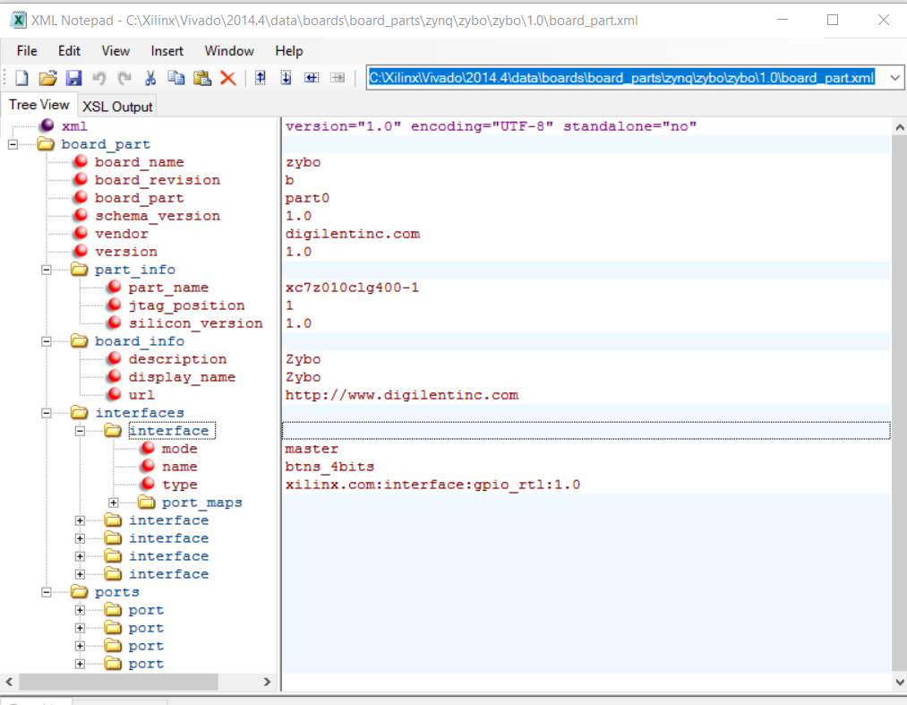
Lecture 12 Zybo Board Definition, LED IP, Lab 5
Zybo Board
Resources
MIO and SelectIO pins
Board Interface Files for Zybo and Vivado
Board Definition File *.xml file
Processing System File *.tcl file
C:\Xilinx\Vivado\2015.2\data\boards\board_parts\zybo\B.3
IP Cores
Lab #5 LED IP and Linker

Slide 2
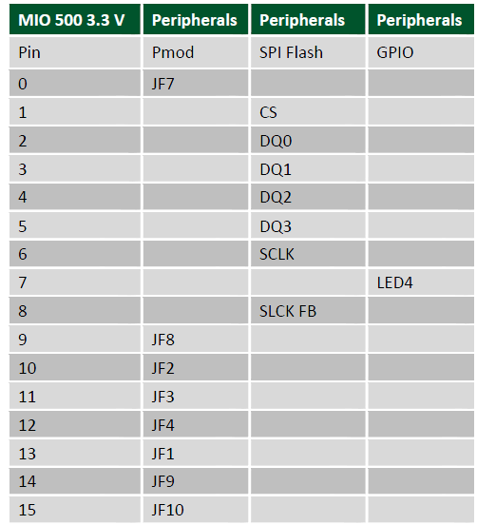
MIO Pins for Processing System (PS) on Zybo
Communication between the PS and external interfaces is achieved primarily via the Multiplexed Input/Output (MIO), which provides 54 pins of flexible connectivity
MIO 0 TO MIO 53
Pmod F
SPI Flash
GPIO for LED4
ZYBO Reference Manual

Slide 3
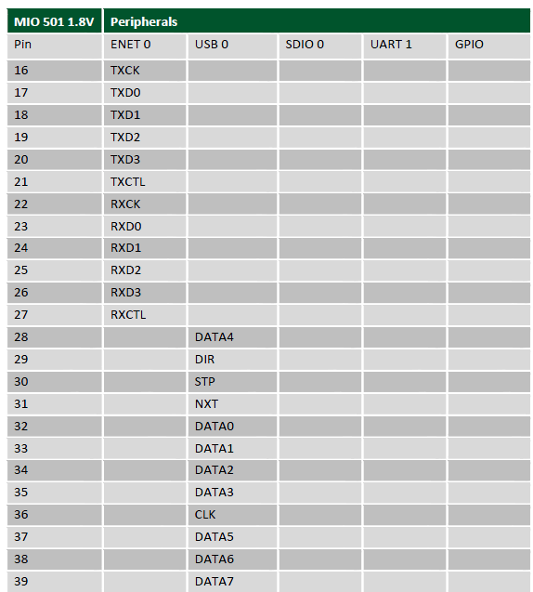
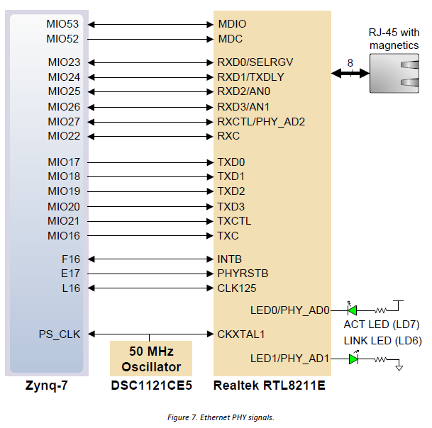
ENET 0 and USB 0: MIO and SelectIO on the Zybo
ENET 0
USB 0
Notice
F16
E17
L16
Notice the external 50MHz Oscillator
ZYBO Reference Manual

Slide 4
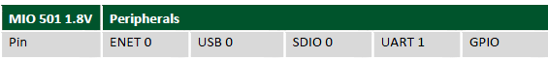
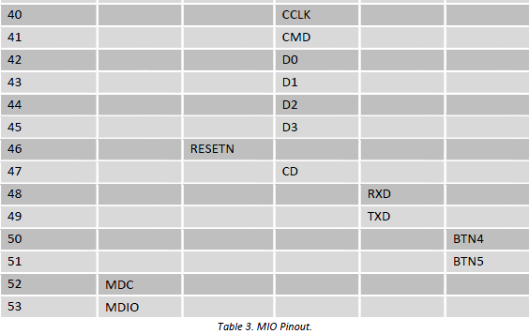
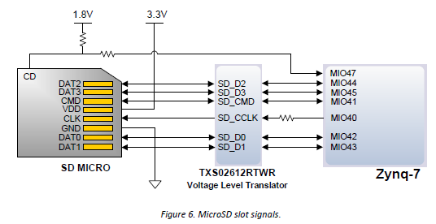
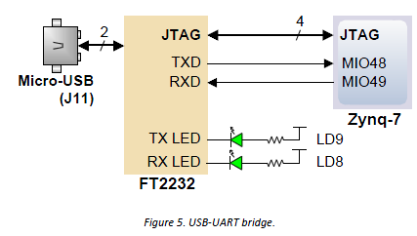
MicroSD: MIO Pins on the Zybo
ENET 0
USB 0
SDIO 0
UART 1
MIO 48,49
GPIO
BTN4, MIO50
BTN5, MIO51
JTAG

Slide 5
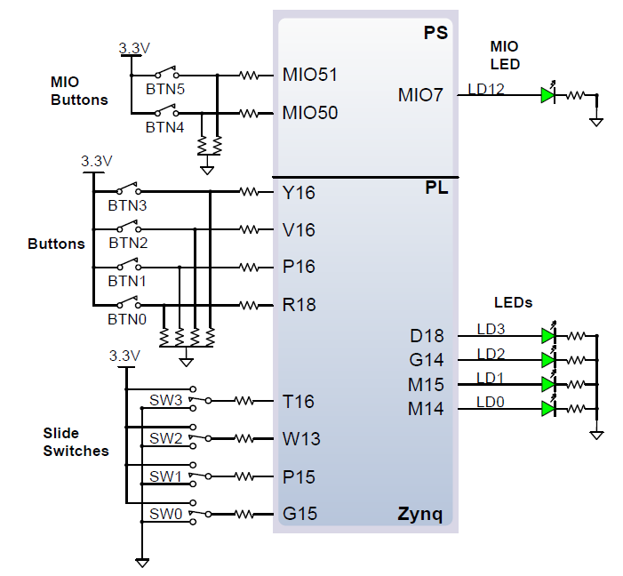
SelectIO pins for Switches and LEDs on Zybo from PS and PL
LEDs on SelectIO: D18, G14, M15, M14
Slide Switches on SelectIO: T16, W13, P15, G15
Buttons on SelectIO: Y16, V16, P16, R18
LED on MIO in PS: MIO7
Buttons on MIO in PS:
MIO51, MIO50
ZYBO Reference Manual

Slide 6
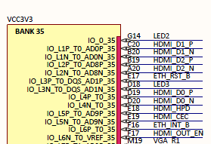
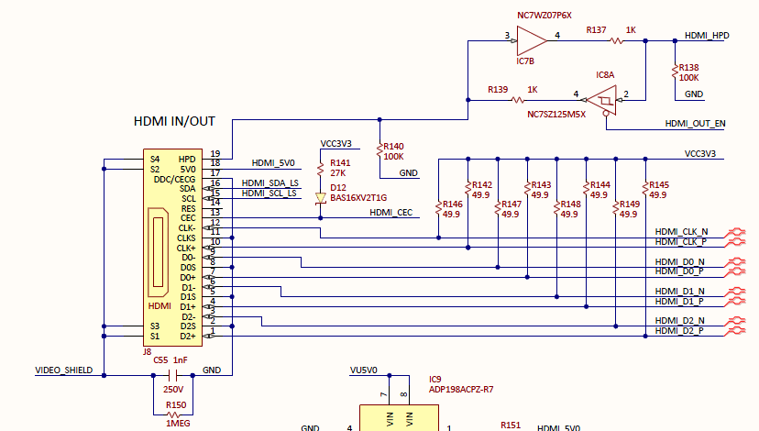
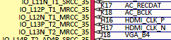
SelectIO pins for HDMI on Zybo
HDMI_CLK_P & _N: H16, H17
HDMI_D1_P & _N : C20, B20
HDMI_D2_P & _N: B19, A20
HDMI_D0_P & _N: D19, D20

Slide 7
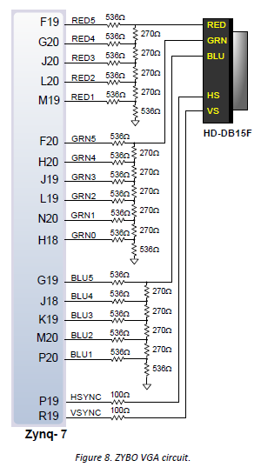
SelectIO pins for VGA on Zybo
ZYBO Reference Manual

Slide 8
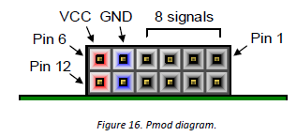
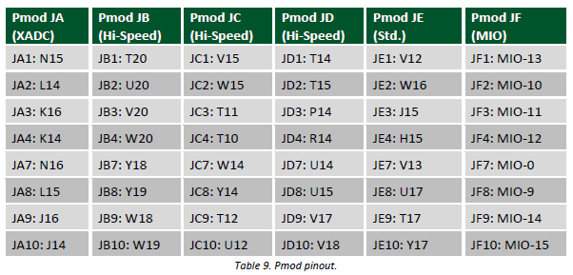
SelectIO pins and EMIO pins for Pmod A to E on Zybo
XADC pins are connected to analog input pins of the PL, 1Volt peak to peak for analog
Hi-Speed pins can be used for high speed differential signals
ZYBO Reference Manual

Slide 9
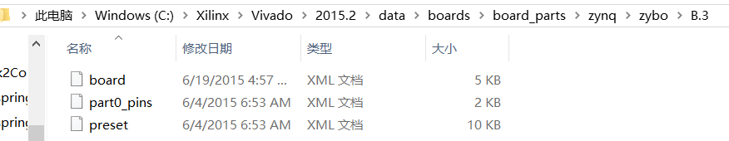
The Board Definition Files for Zybo
The Board definition file uses an XML format to define information about system-level boards that use or include Xilinx devices
<ip_name>.xml is IP Bill of Material (BOM) file that keeps track of the current state of the IP, including generated files, computed parameters, and interface information.
<ip_name>.xdc is timing and/or physical constraints file. These files are not present for all IP, and their location varies by IP.
XML files define different interfaces on the board. Interfaces such as Slide Switches, Push Buttons, LEDs, USB-UART, DDR Memory, Ethernet etc.
ps7.tcl file – this file specifies how Zynq Processing System 7_0 is configured on Zybo board.
TCL, Tool Command Language , is a file extension for a script written in TCL.
ug895-vivado-system-level-design-entry
Notes:
XDC constraints are a combination of: • Industry standard Synopsys Design Constraints (SDC), and • Xilinx proprietary physical constraints XDC constraints have the following properties: • They are not simple strings, but are commands that follow the Tcl semantic. • They can be interpreted like any other Tcl command by the Vivado Tcl interpreter. • They are read in and parsed sequentially the same as other Tcl commands.

Slide 10
tcl files
TCL is a file extension for a script written in TCL. TCL (also pronounced tickle) stands for Tool Command Language. TCL files are text files containing TCL scripts.
Tool Command Language (TCL) is a dynamic open source language used for building web and desktop applications. Whether on Windows, Mac OS X, or Linux operating systems, TCL files can be opened and edited by WISH and TCLSH.
ug895-vivado-system-level-design-entry
Notes:
XDC constraints are a combination of: • Industry standard Synopsys Design Constraints (SDC), and • Xilinx proprietary physical constraints XDC constraints have the following properties: • They are not simple strings, but are commands that follow the Tcl semantic. • They can be interpreted like any other Tcl command by the Vivado Tcl interpreter. • They are read in and parsed sequentially the same as other Tcl commands.

Slide 11
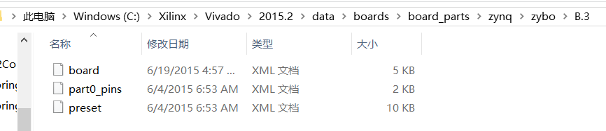
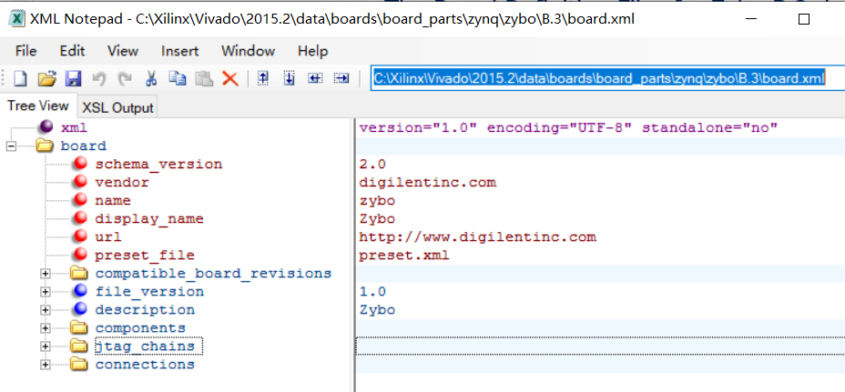
The Board Definition Files for Zybo B.3: board.xml, part0_pins, preset
board.xml contains
part0_pins.xml
preset.xml
Notes:
XDC constraints are a combination of: • Industry standard Synopsys Design Constraints (SDC), and • Xilinx proprietary physical constraints XDC constraints have the following properties: • They are not simple strings, but are commands that follow the Tcl semantic. • They can be interpreted like any other Tcl command by the Vivado Tcl interpreter. • They are read in and parsed sequentially the same as other Tcl commands.

Slide 12
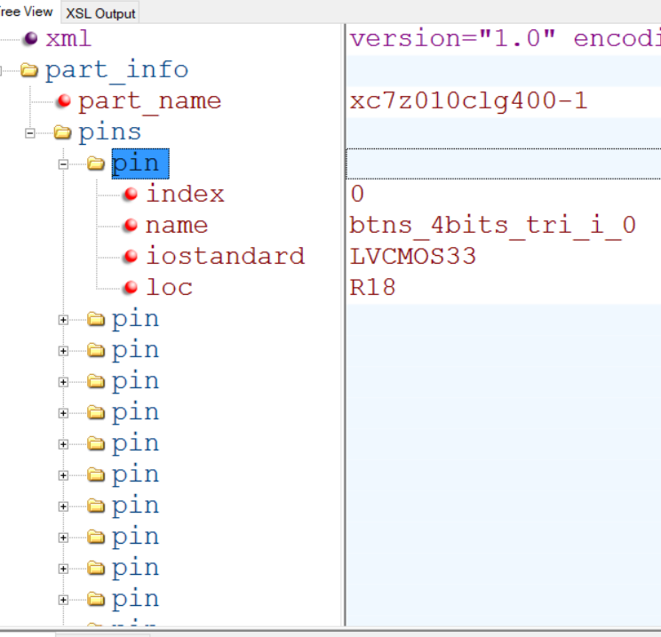
The Board Definition Files for Zybo B.3: part0_pins.xml
Nine pins are defined in part0_pins.xml
Notes:
XDC constraints are a combination of: • Industry standard Synopsys Design Constraints (SDC), and • Xilinx proprietary physical constraints XDC constraints have the following properties: • They are not simple strings, but are commands that follow the Tcl semantic. • They can be interpreted like any other Tcl command by the Vivado Tcl interpreter. • They are read in and parsed sequentially the same as other Tcl commands.

Slide 13
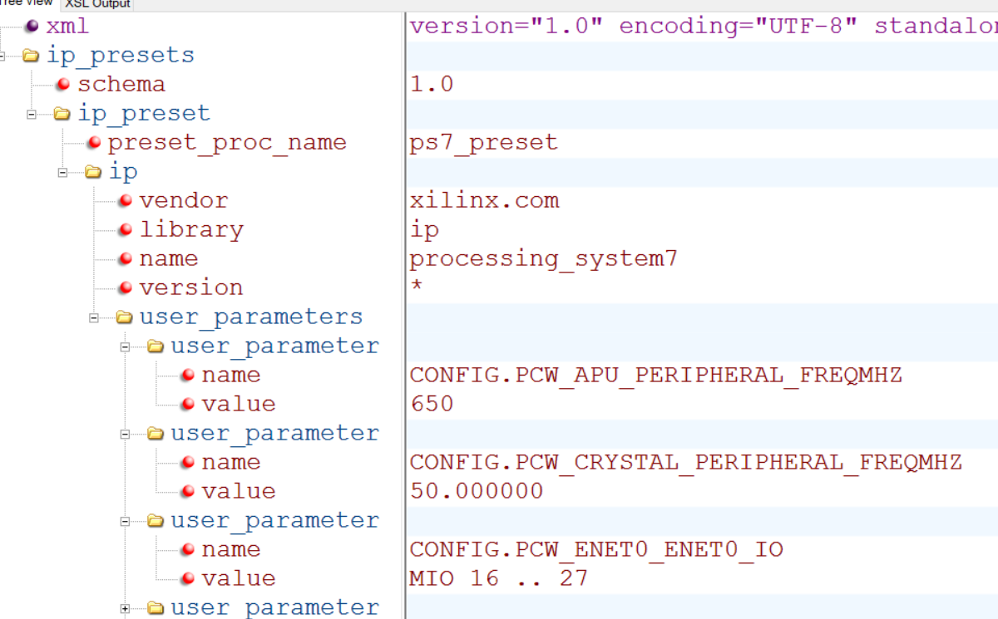
The Board Definition Files for Zybo B.3: preset.xml
Default clock frequencies and MIO pin configurations in preset.xml
Notes:
XDC constraints are a combination of: • Industry standard Synopsys Design Constraints (SDC), and • Xilinx proprietary physical constraints XDC constraints have the following properties: • They are not simple strings, but are commands that follow the Tcl semantic. • They can be interpreted like any other Tcl command by the Vivado Tcl interpreter. • They are read in and parsed sequentially the same as other Tcl commands.

Slide 14
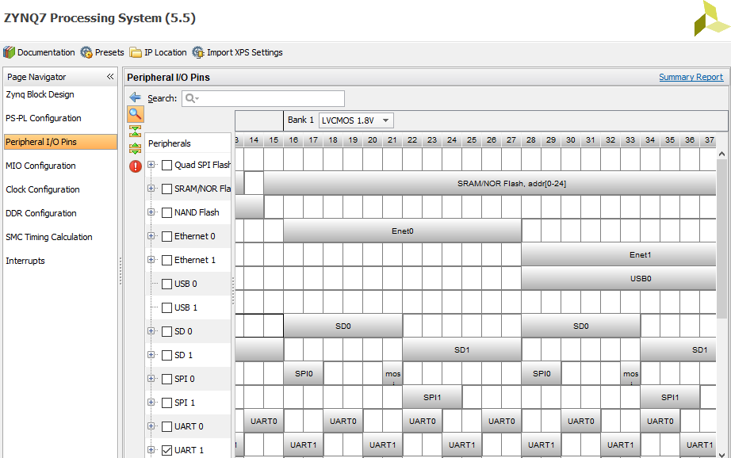
Ethernet 0, Enet0, is connected to MIO 16 to 27
Notes:
XDC constraints are a combination of: • Industry standard Synopsys Design Constraints (SDC), and • Xilinx proprietary physical constraints XDC constraints have the following properties: • They are not simple strings, but are commands that follow the Tcl semantic. • They can be interpreted like any other Tcl command by the Vivado Tcl interpreter. • They are read in and parsed sequentially the same as other Tcl commands.

Slide 15
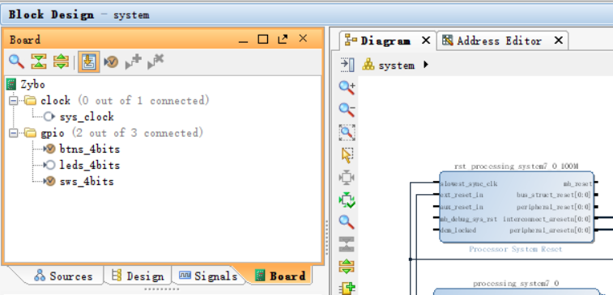
The Board Interface Files for Zybo on Vivado
Board Interface file are listed in the Board tab of the Vivado IP Integrator
When Block Design is opened
Notes:
XDC constraints are a combination of: • Industry standard Synopsys Design Constraints (SDC), and • Xilinx proprietary physical constraints XDC constraints have the following properties: • They are not simple strings, but are commands that follow the Tcl semantic. • They can be interpreted like any other Tcl command by the Vivado Tcl interpreter. • They are read in and parsed sequentially the same as other Tcl commands.

Slide 16
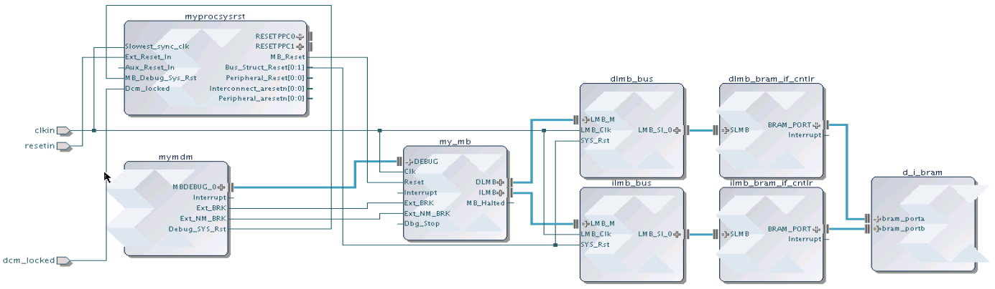
Reusing Your IP
IP from many sources can be packaged and made available in Vivado
All IP available in the Vivado IP Catalog can be used to create IP Integrator designs
Any IP Integrator diagram can be quickly packaged as a single complex IP
Standardized IP-XACT representation
Vivado IP Integrator
IP Catalog
Source (C, RTL, IP, etc)
Simulation Models
IP Packager
Xilinx IP
Documentation
Example Designs
3rd Party IP
Test Bench
User IP

Slide 17
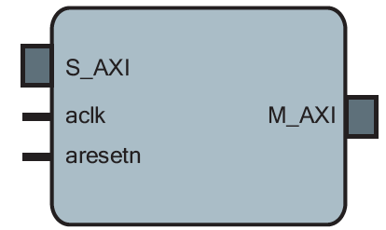
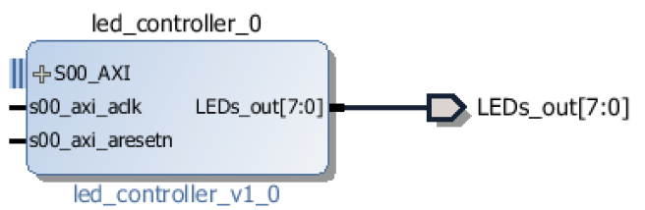
IP Core with AXI Interface
Example of IP Core with AXI Interface
Custom IP Core

Slide 18
Create and Package IP
The Create and Package IP wizard allows you to
Create a template for a new peripheral
Package the current project
Only available if project is open
Package an existing project
The packager allows IP to be included in the IP Catalog for distribution
It uses IP-XACT format
Complete set of files included
Source code, Constraints, Test Benches (simulation files), documentation

Slide 19
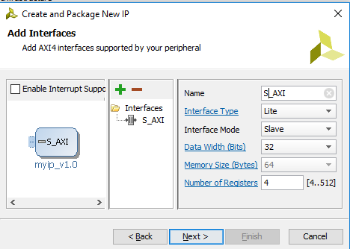
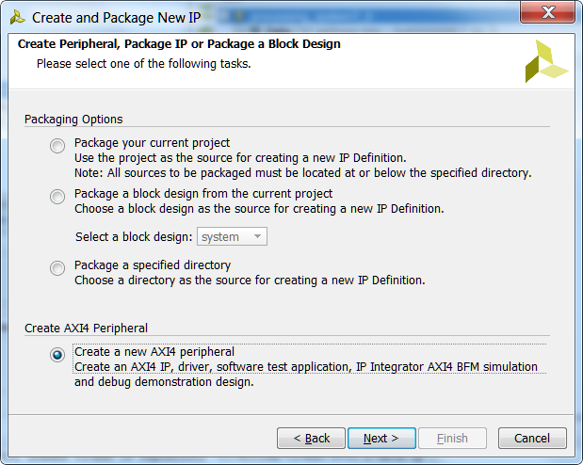
Generated Template for AXI Lite
HDL implementation of AXI Interface
32 bit data width
User specifies required number of registers (minimum 4)
Read/write to/from Registers implemented
User logic can be easily connected
User logic can be a hierarchical design

Slide 20
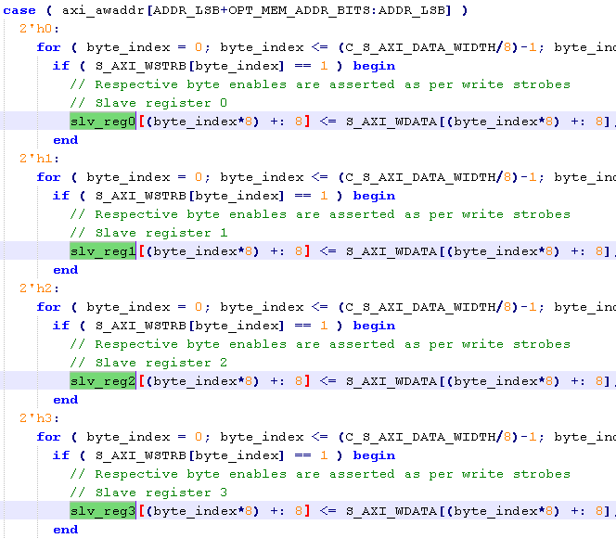
Generated Template for AXI led

Slide 21
Files created
component.xml
IP XACT description
bd
Block Diagram tcl file
drivers
SDK and software files (c code)
Simple register/memory read/write functionality
Simple SelfTest() code
hdl
Verilog/VHDL (should be inside project directory
xgui
GUI tcl file

Slide 22
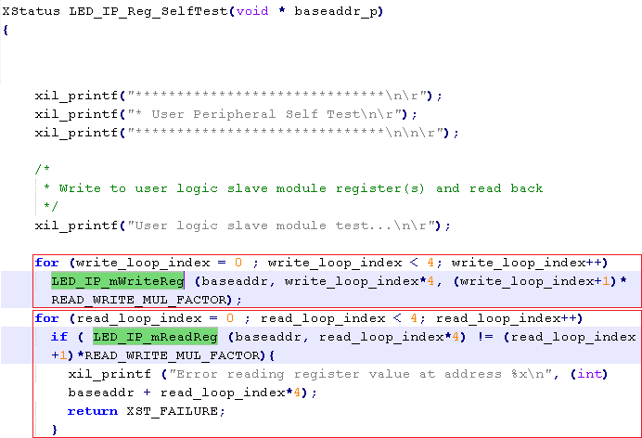
Files created

Slide 23
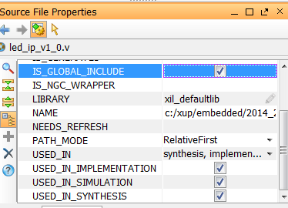
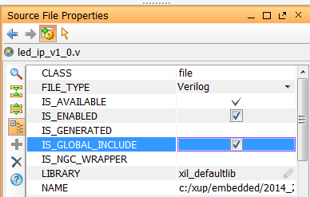
Edit IP
New Vivado project will open
Template files have been generated and are added to the project
IP can now be edited
Modify existing template files, add user source files
IP Packager will be open
Last step is to Package IP
Enable Global Include

Slide 24
Package IP
Package current project
Must be open!
Package generated HDL
Package a directory (another project/source files)
Option to package as a library core
Core can be referenced by other IP
Core not available standalone (Will not display in IP Catalog)
Create New AXI4 Peripheral (previous section)
Will also need to be packaged
Similar steps to package for all three flows

Slide 25

IP-XACT
Industry Standard (IEEE) XML format to describe IP using meta-data
Ports
Interfaces
Configurable Parameters
Files, documentation
IP-XACT only describes high level information about IP, not low level description, so does not replace HDL or Software.
Enables automatic connection, configuration and integration
Enables integration of 3rd Party IP
(And Export of your own IP)

Slide 26
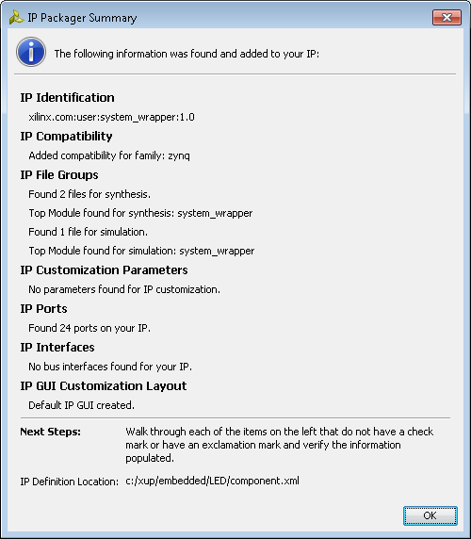
IP Packager
Automatically analyse project/files to determine parameters
Initial Summary
Identifies
Files
Source HDL, Testbenches, Documentation,
Parameters
Configurable
Ports
Interfaces
Compatibility
Creates GUI Layout for IPI

Slide 27
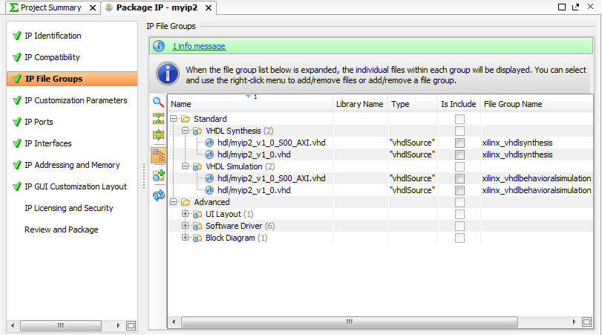
Customizing IP for Reuse in IP Packager
Select
Options
Add, Edit or change defaults
© Copyright 2014 Xilinx

Slide 28
IP repository
The Vivado IP Catalog can be extended by adding additional IP Repositories.
Third party IP, your custom IP, and Xilinx IP are displayed in an identical manner
Packager creates .xml file for the IP
Specify the directory of the user/third party IP repository
Can be done automatically from packager
Access from project settings, or IP Catalog
Displays the IP that has been found
Displays IP in the repository for use in IPI

Slide 29
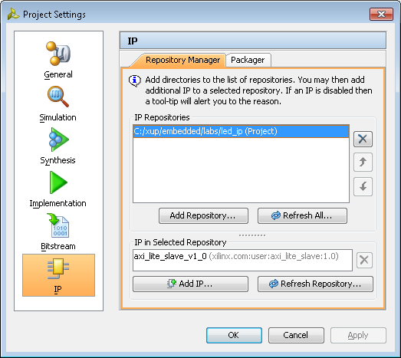
IP repository
Choose Project Manager under Vivado Project to see Project Settings
Select IP to see IP Repositories
One IP, led_ip_v1.0, is seen here.

Slide 30
Lab #5 Part 1: Create Custom IP
Lab #5 Part 1: ZYNQ Lab 3 Use Vivado to Build Embedded Systems, pages ZYNQ3-1 to ZYNQ3-16.
Create and Package IP Wizard
Generates HDL template for
Slave/Master
AXI Lite/Full/Stream
Optionally Generates
Software Driver
Only for AXI Lite and Full slave interface
Test Software Application
AXI4 BFM Example

Slide 31
Lab #5: Adding Custom IP to the System, XUP ZYNQ 3
The User IP in led_ip_v1_0.v contains a register to store LED data
LEDs themselves do not store data, clocked and reset by PS
AXI Interconnect
AXI4-Lite IP (Slave)
led_ip_v1_0_S_AXI.v
led_ip_v1_0.v
User IP
Write Addr
AXI Transaction logic
(Ready, Valid, Response)
User IP
Write Data
Write Response
8-bit output
8-bit LED Register
Read Addr
Registers
Read Data
lab3_user_logic.v

Slide 32
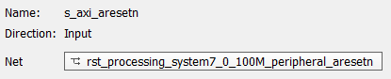
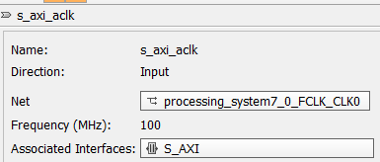
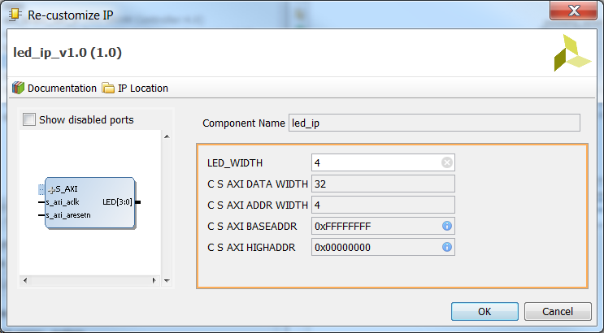
AXI4-Lite Slave Custom IP: led_ip_v1_0.v
S_AXI bus- standard template
axi_aclk
System clock from PS
Axi_aresetn
System reset from PS
LED[3:0]
custom port

Slide 33
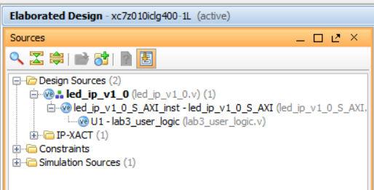
Three Levels: led_ip_v1_0.v, led_ip_v1_0_S_AXI, lab3_user_logic
Top: led_ip_v1_0.v – the wrapper
AXI: led_ip_v1_0_S_AXI – Verilog module
Slave axi4 standard template
Custom: lab3_user_logic – user IP circuit
8-bit LED register to store data
Under IP Editor for led_ip_v1_0

Slide 34
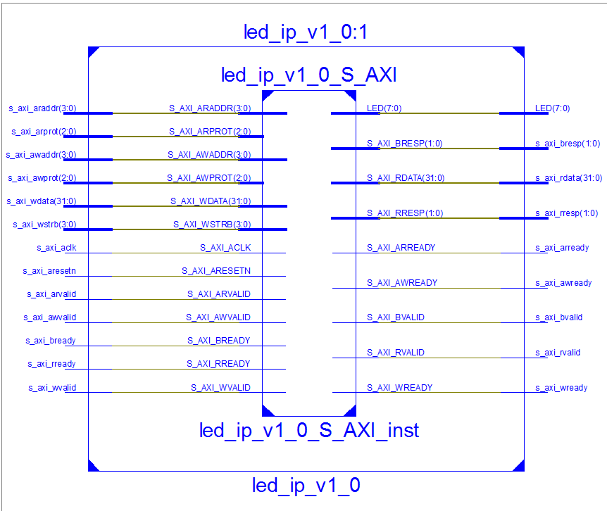
AXI4-Lite Slave IP: led_ip_v1_0.v, led_ip_v1_0_S_AXI, lab3_user_logic
lab3_user_logic

Slide 35
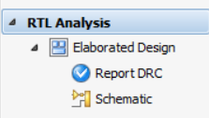
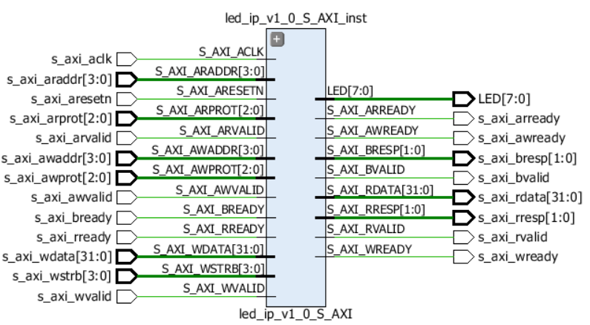
AXI4-Lite Slave IP: module led_ip_v1_0.v
With IP Editor: Run RTL Analysis->Schematic to obtain schematic
4-bit addresses for read s_axi_araddr[3:0] and write s_axi_awaddr[3:0]
8-bit LED LED[7:0], which is a changeable parameter
32-bit read and write data busses

Slide 36
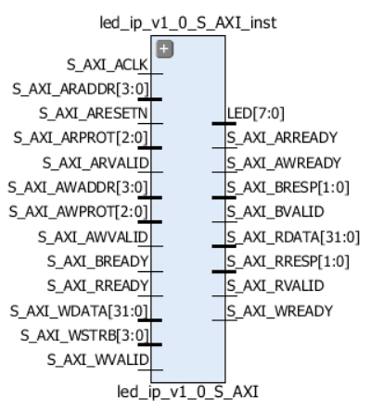
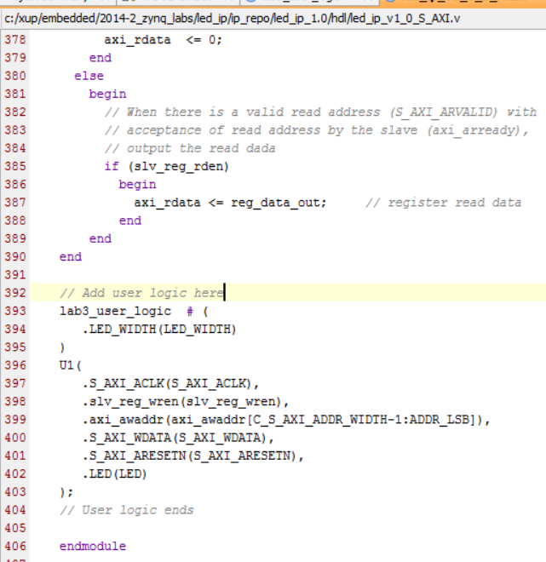
AXI4-Lite Slave IP: , led_ip_v1_0_S_AXI
This is a standard axi4-lite slave module template
lab3_user_logic module is inserted into this template to create a custom ip

Slide 37
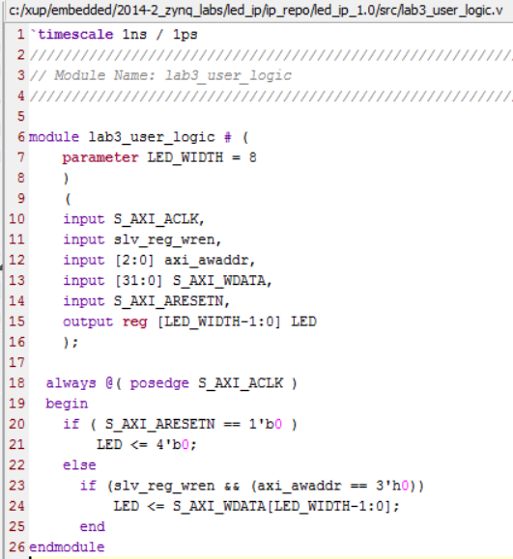
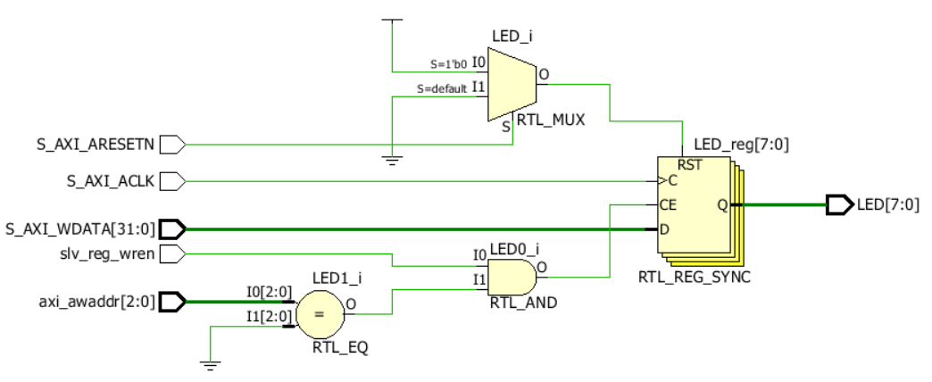
AXI4-Lite Slave IP: module lab3_user_logic
Create an 8 bit register to store 8-bit data of 32-bit Write Data from axi interconnect
This 8-bit data can be displayed on LEDs
Reset by S_AXI_ARESETN
Clocked by S_AXI_ACLK
Enabled by slv_reg_wren and axi_asaddr==3’h0, 12 bit address
Take 8 bits of 32 bit data on S_AXI_WDATA

Slide 38
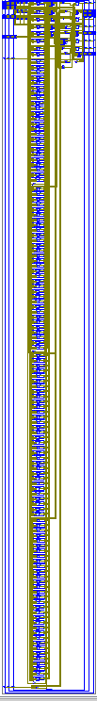
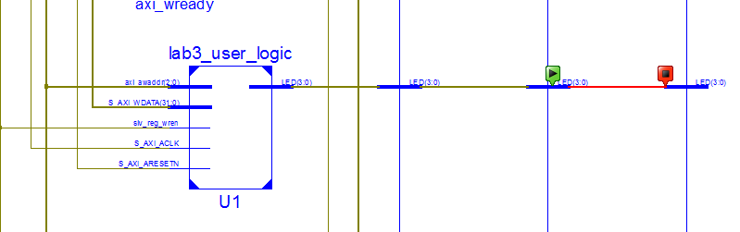
AXI4-Lite Slave IP: lab3_user_logic module, 3 level deep
lab3_user_logic.v under led_ip_v1_0_S_AXI.v
lab3_user_logic

Slide 39
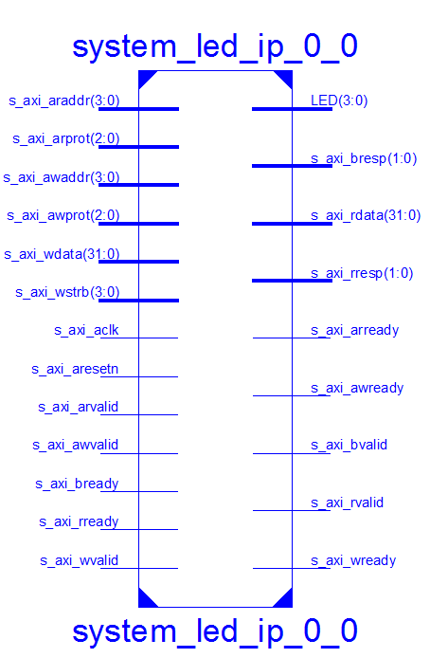
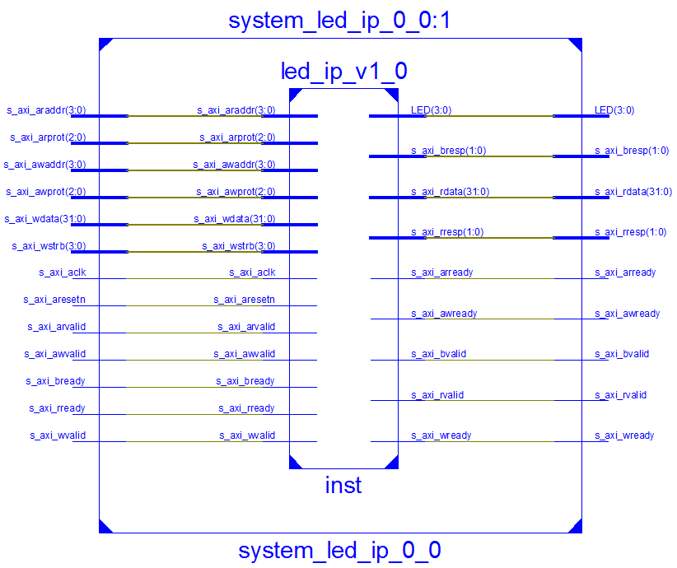
One Instance of led_ip_v1_0.v with four LEDs
System_led_ip_0_0.v == led_ip_v1_0.v, notice LED[3:0]

Slide 40
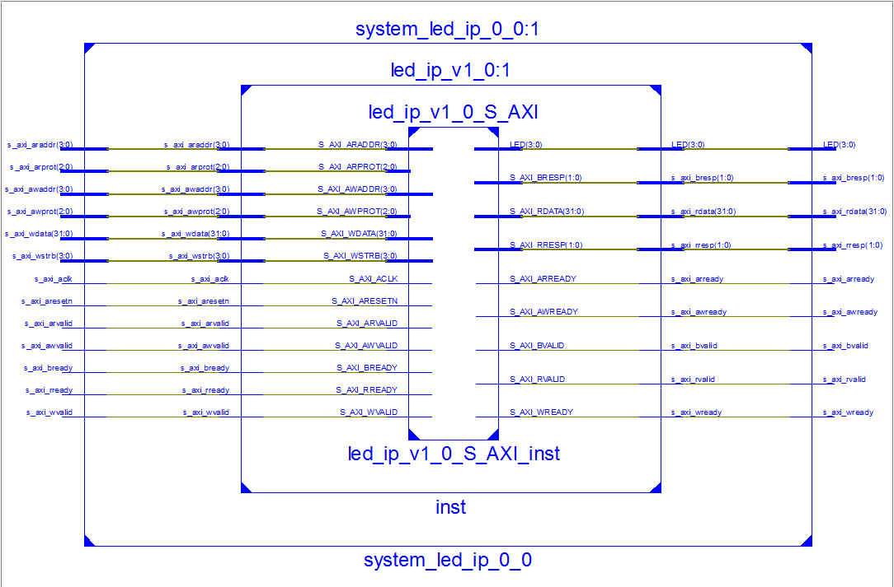
One Instance of led_ip_v1_0.v with four LEDs
System_led_ip_0_0.v == led_ip_v1_0.v, notice LED[3:0]
lab3_user_logic.v is in led_ip_v1_0_S_AXI_inst

Slide 41


Add constraints file lab3_zybo.xdc
############################
# On-board LED #
############################
set_property PACKAGE_PIN M14 [get_ports LED[0]]
set_property IOSTANDARD LVCMOS33 [get_ports LED[0]]
set_property PACKAGE_PIN M15 [get_ports LED[1]]
set_property IOSTANDARD LVCMOS33 [get_ports LED[1]]
set_property PACKAGE_PIN G14 [get_ports LED[2]]
set_property IOSTANDARD LVCMOS33 [get_ports LED[2]]
set_property PACKAGE_PIN D18 [get_ports LED[3]]
set_property IOSTANDARD LVCMOS33 [get_ports LED[3]]
Specify pin positions where LEDs are located.

Slide 42


Xilinx Design Constraints (XDC) File for Zybo: Master XDC zip
A zipped file called ZYBO_Master.xdc is available from https://reference.digilentinc.com/zybo:zybo#documentation
Here is the header of ZYBO_Master.xdc

Slide 43
Xilinx Design Constraints File
The Xilinx® Vivado® Integrated Design Environment (IDE) uses Xilinx Design Constraints (XDC)
It does not support the legacy User Constraints File (UCF) format.
There are key differences between Xilinx Design Constraints (XDC) and User Constraints File (UCF) constraints.
XDC constraints are based on the standard Synopsys Design Constraints (SDC) format.
I/O constraints configure:
Ports
Cells connected to ports
Typical constraints include:
I/O standard
I/O location

Slide 44

Lab #5 top Level Circuit
buttons and switches are standard S_AXI4 lite interfaces
led_ip_0 and axi_bram_ctrl_0 are custom IP S_AXI4 interfaces

Slide 45

Lab #5 top Level Circuit
buttons and switches are standard S_AXI4 lite interfaces
led_ip_0 and axi_bram_ctrl_0 are custom IP S_AXI4 interfaces

Slide 46




Board Support Package: Block RAM interface for Zynq-7010
AXI Block RAM controller IP, AXI4 Slave
Block RAM IP, Single Port RAM
36Kb block RAM x 60 blocks
True dual-port
Up to 72 bits wide
Configurable as dual 18 Kb block RAMs

Slide 47


Synchronous Dual-Port and Single-Port RAMs (UG473 7 Series FPGAs Memory)
Two independent access ports
No arbitration between the ports
Write conflict will not cause physical damage but may cause data loss
Zynq-2010 BRAM: 36Kbx60=2.16Mb

Slide 48



SDK Project: Source files, Linker Script, BSP, Hardware Platform
Software Project
Source code
Linker script file
Board Support Package *.bsp
Hardware Platform – system_wrapper
Linker Script
© Copyright 2014 Xilinx

Slide 49

Linker Properties
The Root panel displays properties for the selected configuration
Shown are the linker options for the Debug configuration
Default settings are fine for simple applications

Slide 50
Address Management
Embedded processor design requires you to manage the following:
Address map for the peripherals
Location of the application code in the memory space
Block RAM
SRAM
External memory (Flash, DDR3)
Memory requirements for your programs are based on the following:
The amount of memory required for storing the instructions
The amount of memory required for storing the data associated with the program

Slide 51

Standard ARM Programming Model
Processing system and programmable logic look the same
AMBA® and AXI interfaces
Memory-mapped I/O
Register access
Consistency for PS and PL = ease of use
Memory map usage: total of 4 GB
1 GB: DDR RAM
2 GB: dedicated to PL peripherals
1 GB: PS peripherals, on-chip memory (OCM), external flash

Slide 52


Programmer’s View of Programmable Logic
Programmable logic (PL) memory map
2 GB total space
1 GB for each AXI master: GP0, and GP1
Accessible from any processing system (PS) master
Either Cortex-A9 CPU
PS DMA engine
PS peripheral DMA engine
Ethernet
USB
SD/SDIO
Custom Peripheral
Code Snippet

Slide 53

Address Map: I/O Peripherals (Zynq AP SoC)

Slide 54
Linker Script
Linker script controls the linking process
Map the code and data to a specified memory space
Set the entry point to the executable
Reserve space for the stack
Required if the design contains a discontinuous memory space

Slide 55
Linker and Locator Flows
foo1.o
Executable Image
Merged Output Sections
0xFFFF
.text1
Code
.data1
.text
Locate
0xF000
.bss1
0xEFFF
Link
.data
uninitialized data
0xEF00
foo2.o
0xEEFF
.bss
.text2
Unused
0x2000
.data2
0x1FFF
Initialized data
.bss2
0x0000

Slide 56


Linker Script Generator GUI
Table-based GUI allows you to define the memory space for code and data sections
Launch from Xilinx Tools > Generate Linker Script, or from the C/C++ perspective, right-click on <project> > Generate Linker Script
The tool will create a new linker script (the old script is backed up)

Slide 57

Linker Script Generator GUI
File location: C:\Xilinx\embedded\2015_2_zynq_labs\lab4\lab4.sdk\lab4\src\lscript.ld

Slide 58
Lab #5: Writing Basic Software Application and Block RAM
ARM
Cortex-A9
PL
Memory
DDR3
Memory
Controller
RS232
UART
AXI
Interconnect
Block
AXI4
AXI-BRAM Controller
BRAM
AXI4-Lite
LED_IP
LED
M_AXI_GP0
AXI4-Lite
GPIO
Push-Buttons
PS
AXI4-Lite
GPIO
DIP Switches

Slide 59

Board Support Package Macros in led_ip.h
#ifndef LED_IP_H
#define LED_IP_H
/****************** Include Files ********************/
#include "xil_types.h"
#include "xstatus.h"
#define LED_IP_S_AXI_SLV_REG0_OFFSET 0
#define LED_IP_S_AXI_SLV_REG1_OFFSET 4
#define LED_IP_S_AXI_SLV_REG2_OFFSET 8
#define LED_IP_S_AXI_SLV_REG3_OFFSET 12
#define LED_IP_mWriteReg(BaseAddress, RegOffset, Data) \
Xil_Out32((BaseAddress) + (RegOffset), (u32)(Data))
#define LED_IP_mReadReg(BaseAddress, RegOffset) \
Xil_In32((BaseAddress) + (RegOffset))
XStatus LED_IP_Reg_SelfTest(void * baseaddr_p);

Slide 60
Xil_Out32(), Xil_in32() in standard_v4_2/src/xil_io.c
/* Performs an input operation for a 32-bit memory location by reading from the
* specified address and returning the Value read from that address.
** @paramAddr contains the address to perform the input operation at.
* @returnThe Value read from the specified input address.
* @noteNone. */
u32 Xil_In32(u32 Addr)
{
return *(volatile u32 *) Addr;
}
Read (return) content at address Addr
/* Performs an output operation for a 32-bit memory location by writing the
* specified Value to the specified address.
* @paramOutAddress contains the address to perform the output operation at.
* @paramValue contains the Value to be output at the specified address.
* @returnNone.
* @noteNone */
void Xil_Out32(u32 OutAddress, u32 Value)
{
*(volatile u32 *) OutAddress = Value;
}
Write (store) Value to content at address Addr

Slide 61
LED device defined in xparameters.h
/* Definitions for driver LED_IP */
#define XPAR_LED_IP_NUM_INSTANCES 1
/* Definitions for peripheral LED_IP_0 */
#define XPAR_LED_IP_0_DEVICE_ID 0
#define XPAR_LED_IP_0_S_AXI_BASEADDR 0x43C00000
#define XPAR_LED_IP_0_S_AXI_HIGHADDR 0x43C0FFFF

Slide 62

Lab #5 main() to display slide switch values on LEDs
#include "xparameters.h"
#include "xgpio.h"
#include "led_ip.h"
int main (void)
{
XGpio dip, push;
int i, psb_check, dip_check;
xil_printf("-- Start of the Program --\r\n");
XGpio_Initialize(&dip, XPAR_SWITCHES_DEVICE_ID);
XGpio_SetDataDirection(&dip, 1, 0xffffffff);
XGpio_Initialize(&push, XPAR_BUTTONS_DEVICE_ID);
XGpio_SetDataDirection(&push, 1, 0xffffffff);
while (1) {
psb_check = XGpio_DiscreteRead(&push, 1);
xil_printf("Push Buttons Status %x\r\n", psb_check);
dip_check = XGpio_DiscreteRead(&dip, 1);
xil_printf("DIP Switch Status %x\r\n", dip_check);
LED_IP_mWriteReg(XPAR_LED_IP_S_AXI_BASEADDR,0,dip_check);
for (i=0; i<9999999; i++); }
}

Slide 63

Three Linker Memory Options: Internal, Block RAM, DDR
ps7_ram_0_S_AXI_BASEADDR, fastest, internal RAM in PS based at 0x00000000 or 0xFFFF0000
ps7_ddr_0_S_AXI_BASEADDR, faster, external DDR memory based at 0x00100000
axi_bram_ctrl_0, slow, very slow – internal block RAM in PL based at 0x40000000

Slide 64

Memory Clock Speeds: Internal, Block RAM, DDR
650MHz - ps7_ram_0_S_AXI_BASEADDR
525MHz - ps7_ddr_0_S_AXI_BASEADDR
100MHz - axi_bram_ctrl_0

Slide 65

Heap and Stack with Internal RAM: ps7_ram_0_S_AXI_BASEADDR

Slide 66

Object Dump
Display information from object files and executables
Header information, memory map
Data
Disassemble code
Byte alignment
arm-xilinx-eabi-objdump –h executable.elf
Section
Name
Virtual Memory Address
Loadable Memory Address
Section Size
Offset from the beginning of the section header table

Slide 67

Heap and Stack with Internal RAM: ps7_ram_0_S_AXI_BASEADDR
RAM base address 0x00000000
Heap address 0x00008030
Stack address 0x00008430

Slide 68

Block RAM: axi_bram_ctrl_0

Slide 69

Heap and Stack with Block RAM: axi_bram_ctrl_0
Block RAM base address 0x40000000
Heap address 0x4000000
Stack address 0x40000400

